Slide 1
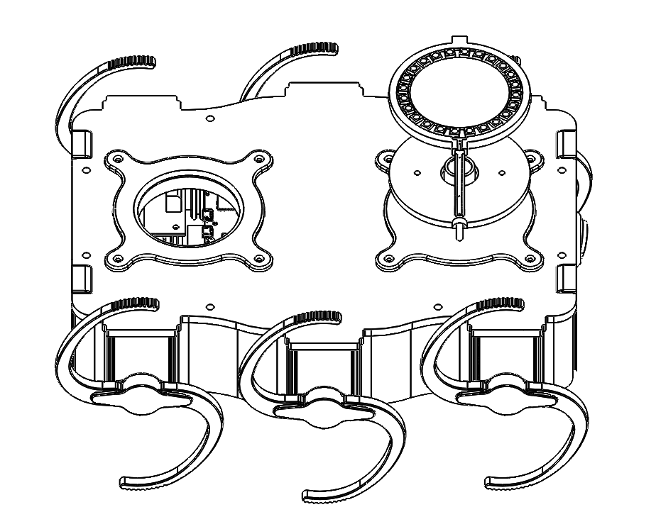
Development of an Omni-directional distance sensing system for the Deci Zebro
S.G. Verkamman K. Kouwenhoven

Slide 2
Overview
Problem definition
Programme of requirements (PoR)
Concepts
System synthesis
Prototype and performance
Discussion and conclusion

Slide 3
Problem definition
Find relative distance of neighbours in swarm
Identical modules
Provide Zebro “brain” with information on neighbours:
  Distance
  Angle relative to heading

Slide 4
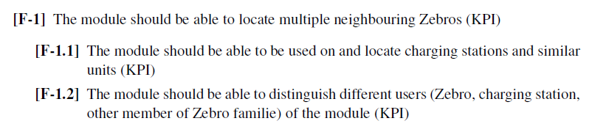
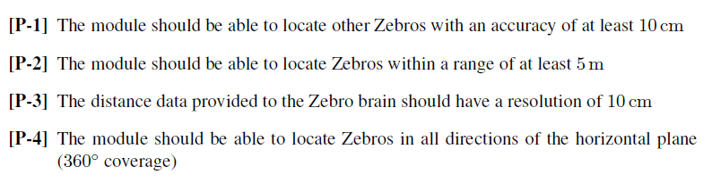
Programme of requirements (PoR)

Slide 5
Concepts
Received signal strength indicator (RSSI)
Time of flight
Angle of arrival (AOA)
Time difference of arrival (TDOA)

Slide 6
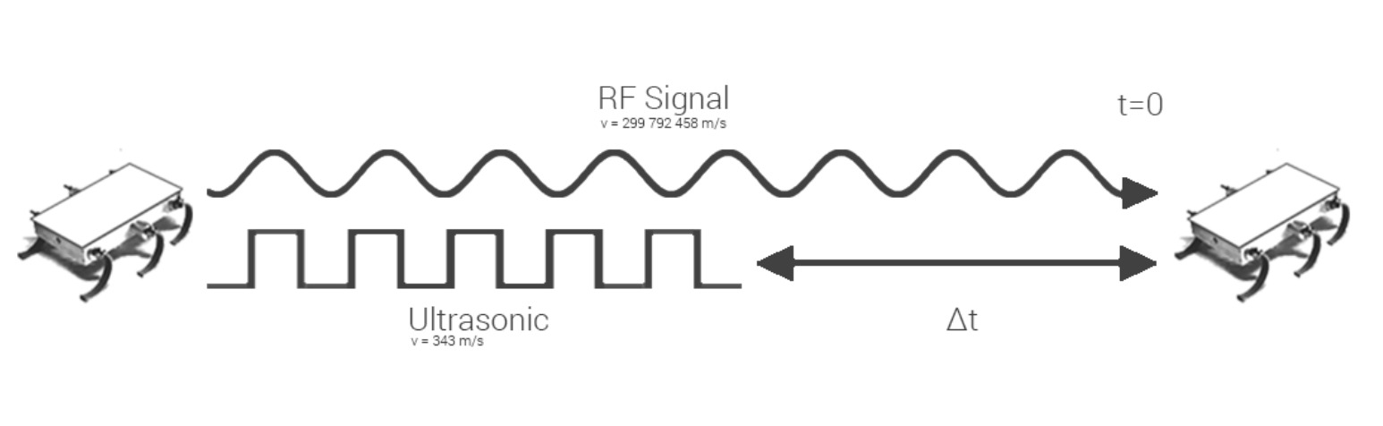
Concepts

Slide 7
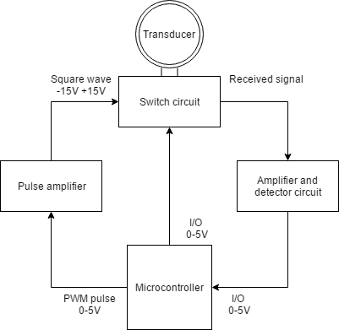
System synthesis
Transmitter circuit
Receiver circuit
Reflector antenna

Slide 8
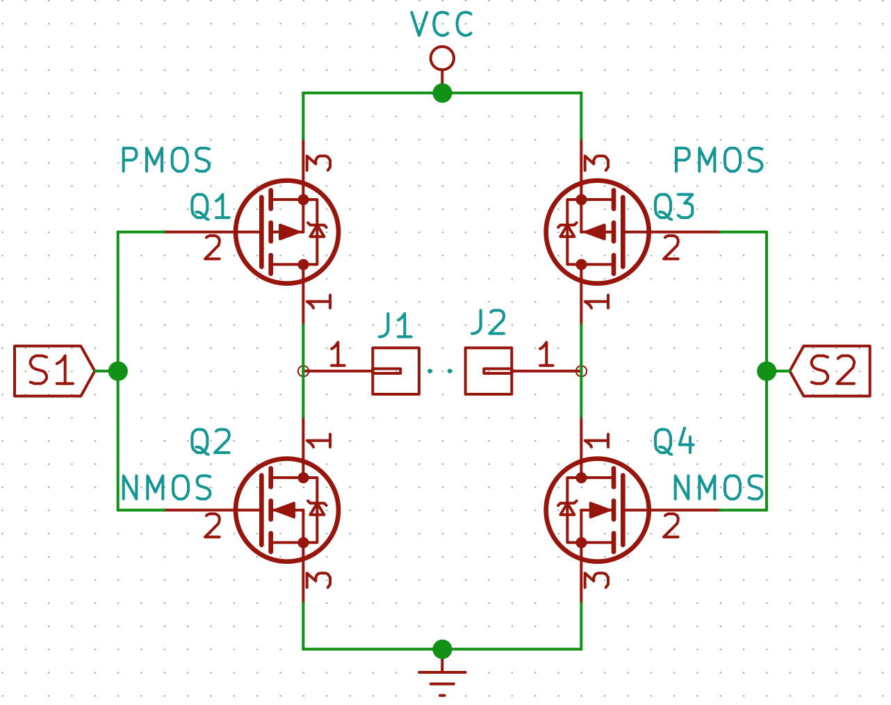
Transmitter circuit

Slide 9
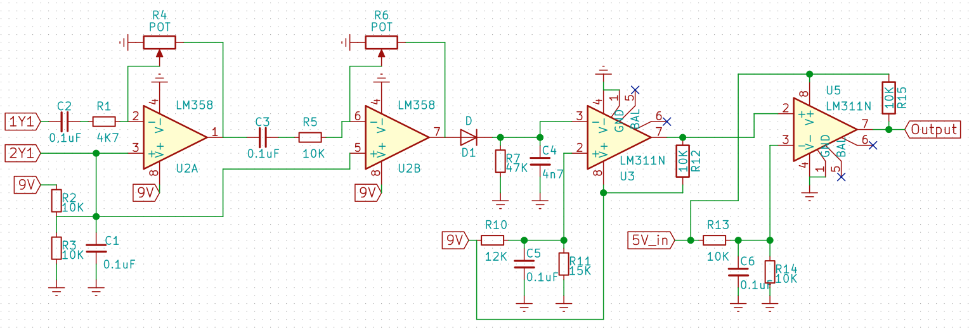
Receiver circuit

Slide 10
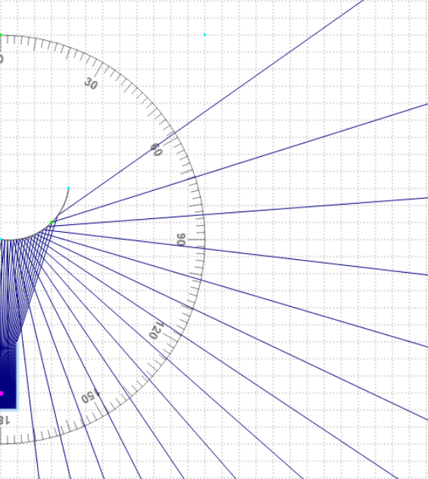
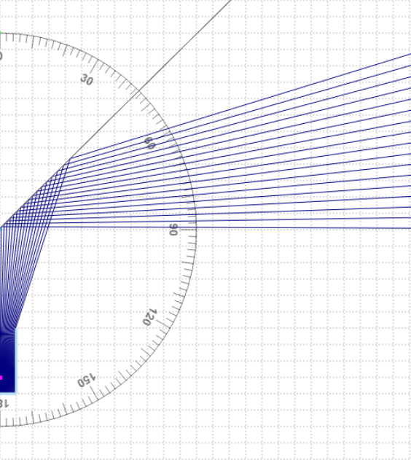
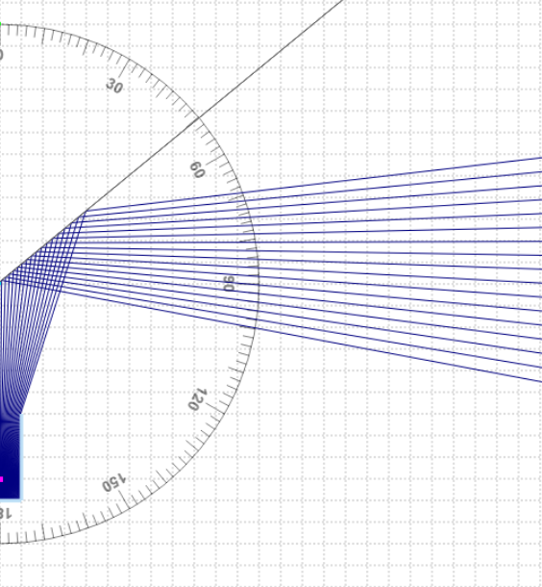
Reflector antenna

Slide 11
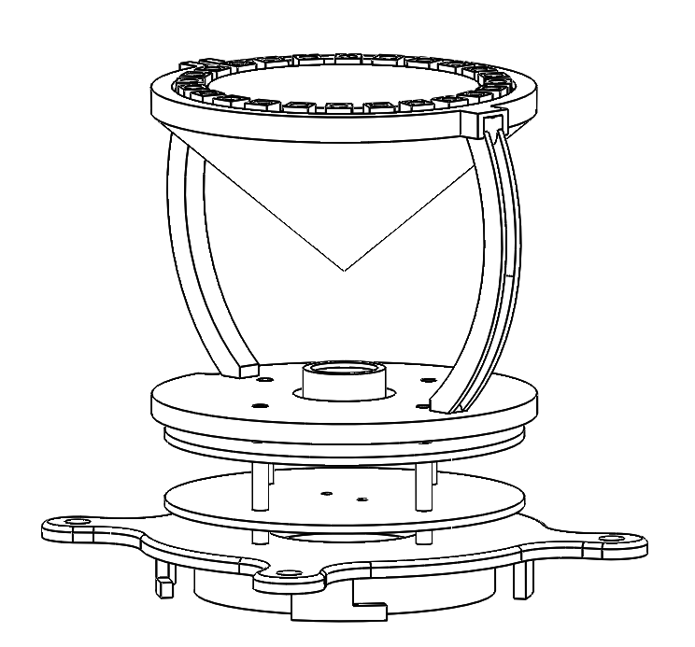
Prototype

Slide 12
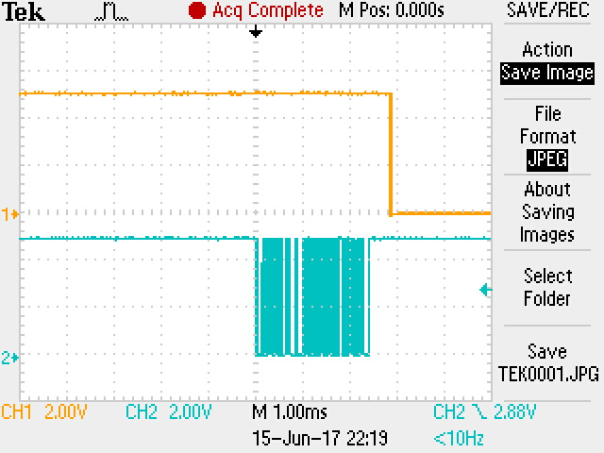
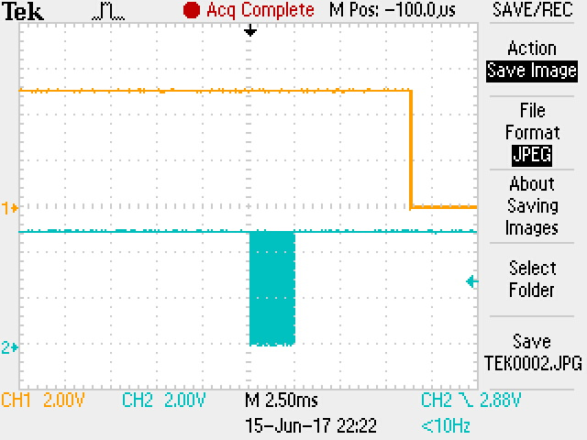
Prototype performance

Slide 13
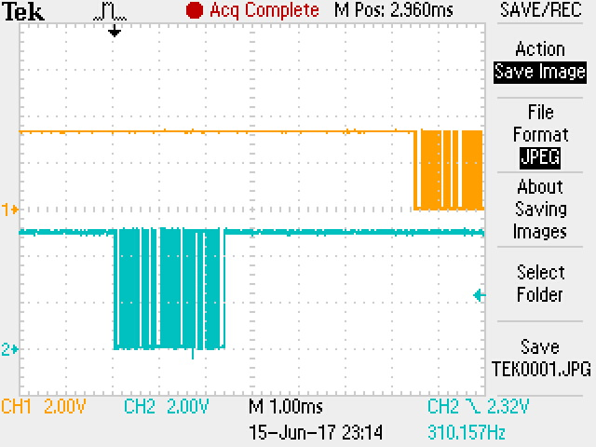
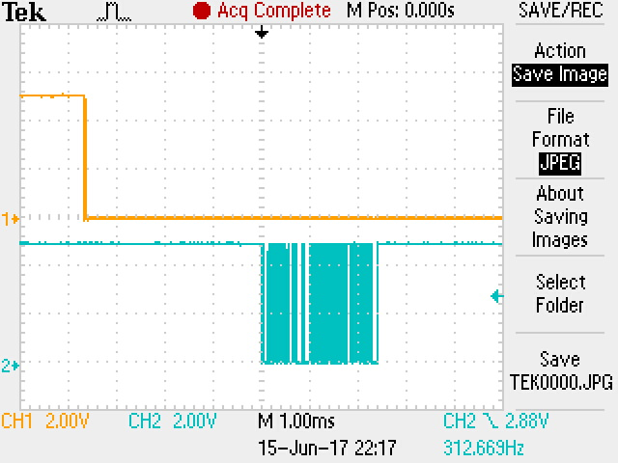
Discussion

Slide 14
New Results??

Slide 15
Conclusion
Range: 7m
Accuracy: 17cm
Resolution: 8mm
Future

Slide 18
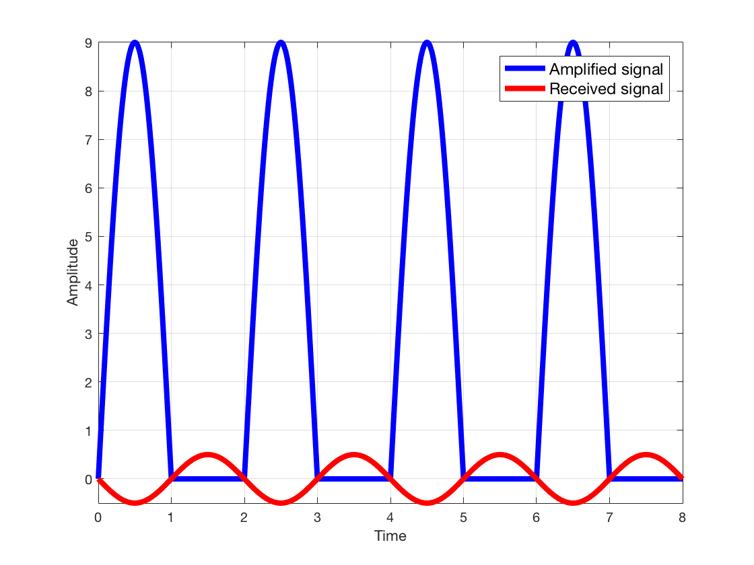
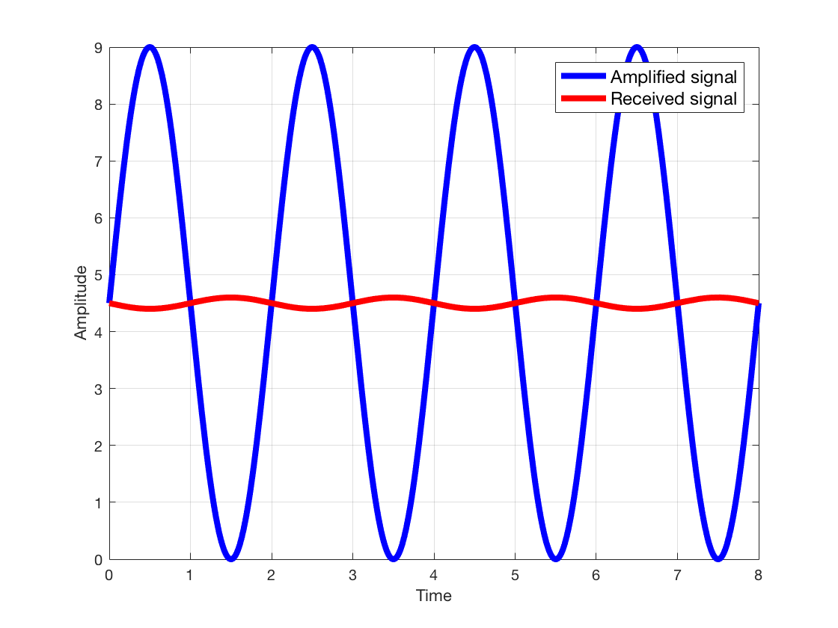
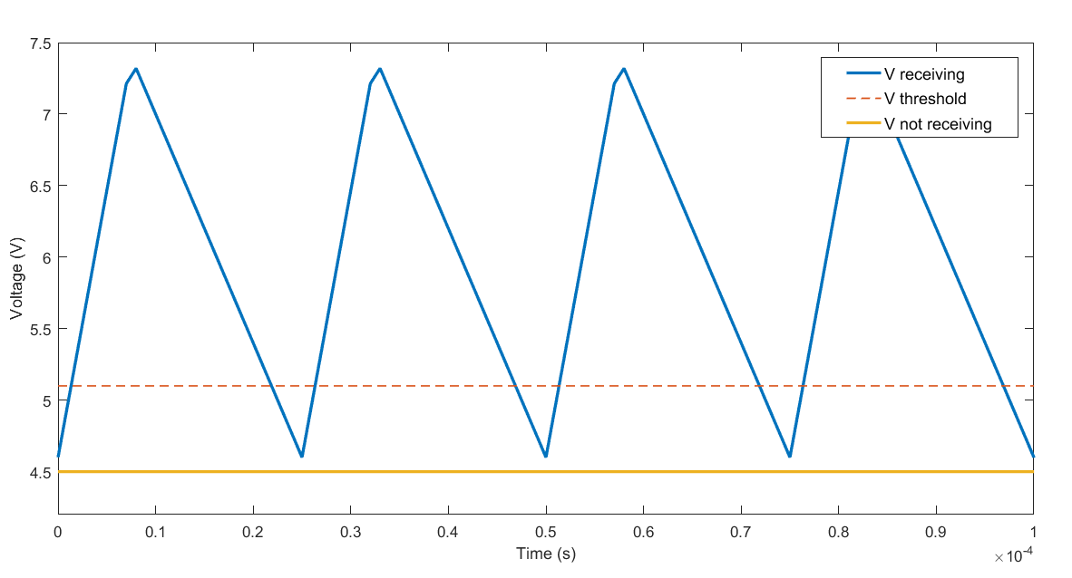

Slide 19
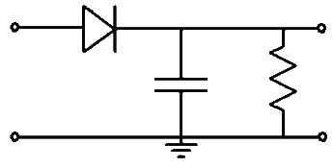
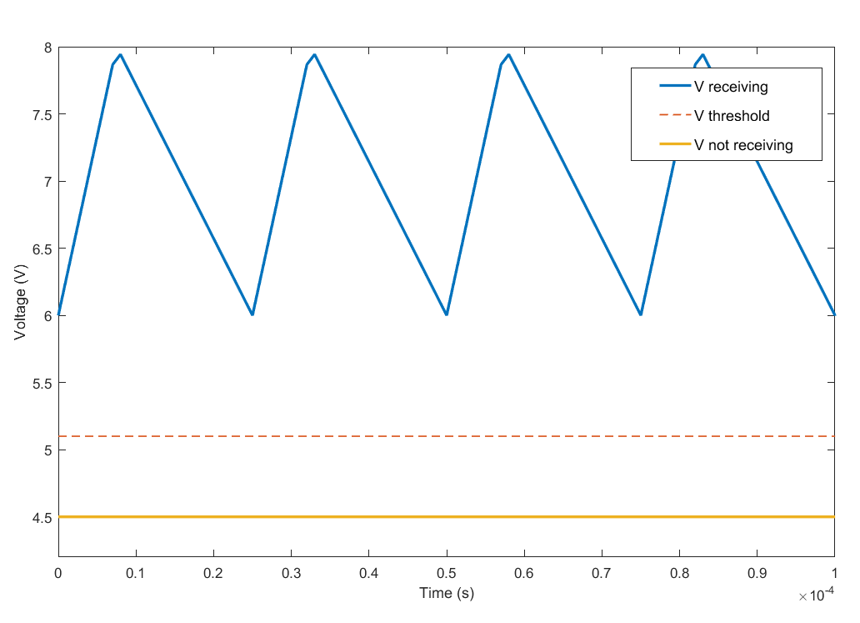

Slide 20
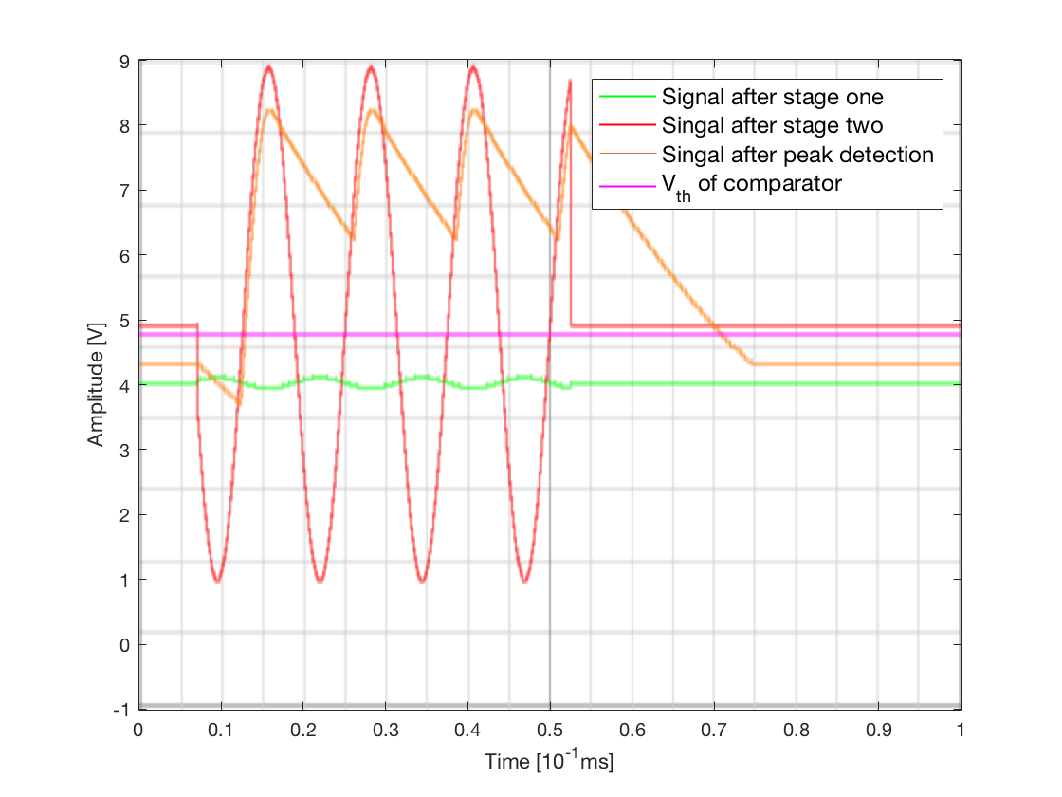
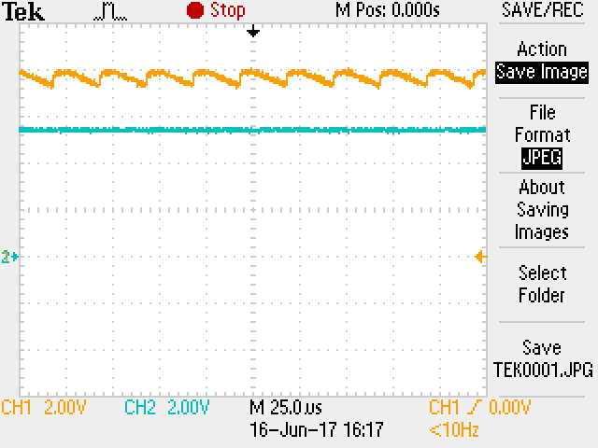

Slide 21
